Slide 1


Slide 2

ONLINE FOOD DELIVEY SYSTEM

Slide 3
PRESENTER INTRODUCTION
I, Name of student, a 25-year-old aspiring web developer with a passion for creating innovative web-based solutions.
As a student of the Virtual University, my ID is BC.
I am currently working on developing a user-friendly Online food delivery system designed to facilitate the people to deliver the food at their homes
My expertise includes HTML, CSS, JavaScript, Bootstrap, PHP, and SQL, which I am leveraging to build this impactful project.

Slide 4
INTRODUCTION OF THE PROJECT
The Online Food Delivery System website is designed to provide a streamlined and efficient platform for delivery of foods services.
The scope of the website includes the following key elements:
Simple and intuitive online form for booking online food services, including :
An Online Food Delivery System is a web application through which customers can choose the restaurant of their choice and order specific food from their homes, offices, or hostels.
The goal of this application is to make a web application for a company to deliver good quality food to the customers and the customer will get the food of their choice at home without any hassle.

Slide 5
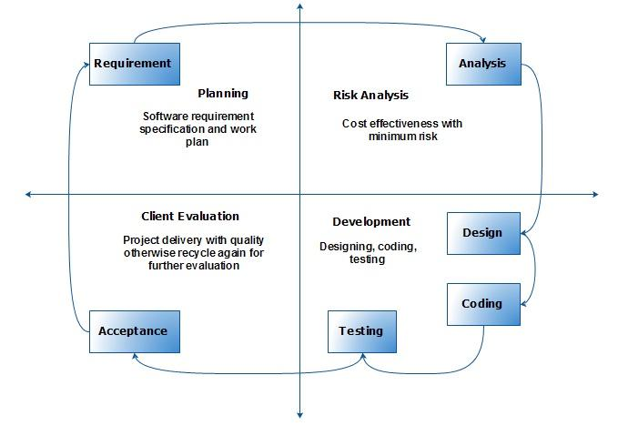
PROCESS MODEL DAIGRAM

Slide 6
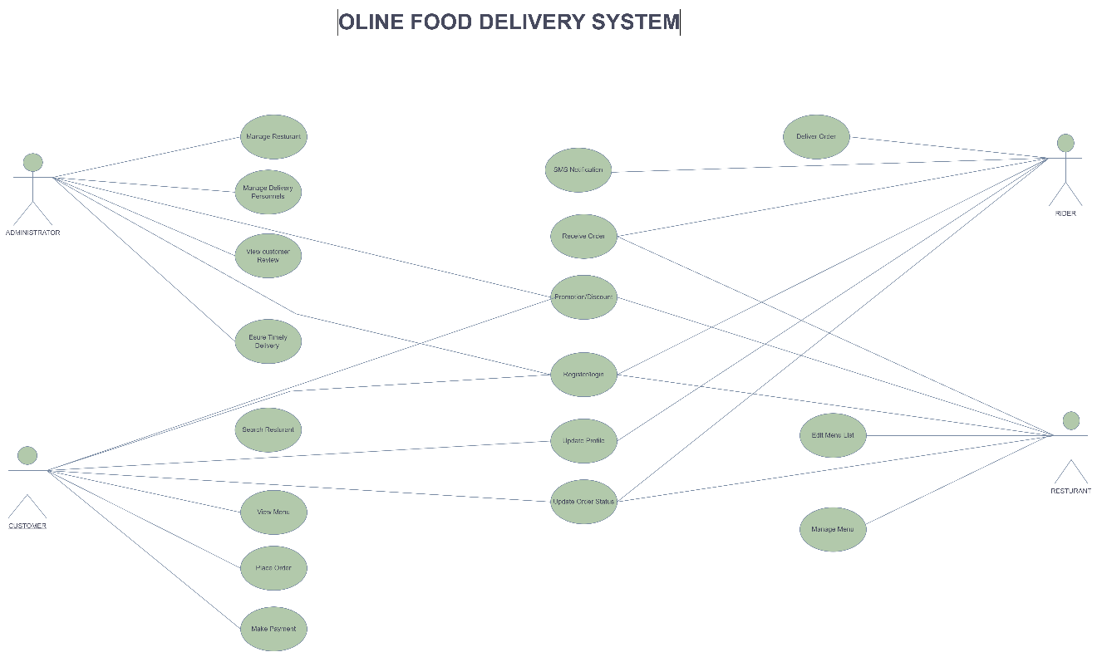
USE-CASE DAIGRAM

Slide 7
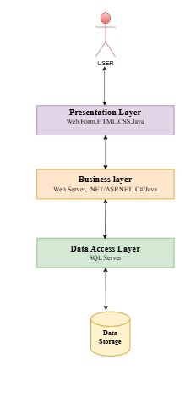
ARCHITECTURAL DESIGN

Slide 8
TEAM STRUCTURE
As the sole developer of this project, I will manage all aspects, including planning, design, and development.
Responsibilities include frontend development using HTML, CSS, and JavaScript, backend development with PHP and MySQL.

Slide 9
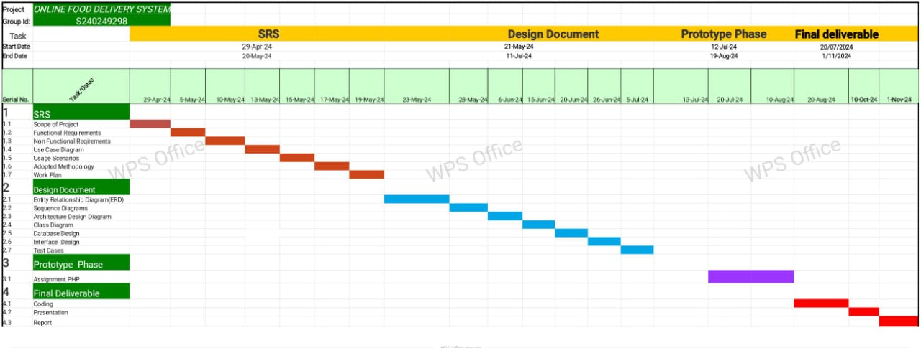
PROJECT SCHEDULE

Slide 10
SEQUENCE DAIGRAMS

Slide 11
SEQUENCE DAIGRAMS

Slide 12
SEQUENCE DAIGRAMS

Slide 13
SEQUENCE DAIGRAMS

Slide 14
LOGICAL MODEL / CLASS DIAGRAM

Slide 15
ENTITY-RELATIONSHIP DIAGRAM

Slide 16
DATABASE DIAGRAM

Slide 17
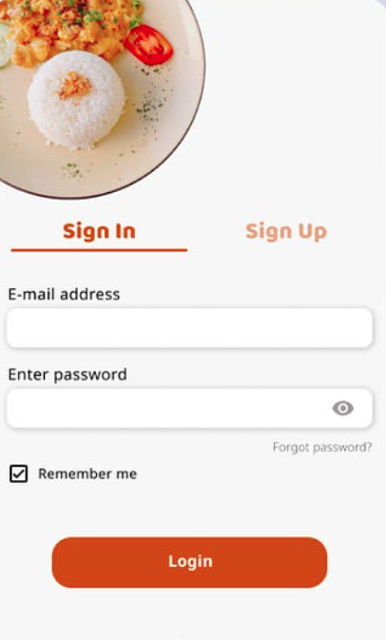
USER INTERFACES

Slide 18
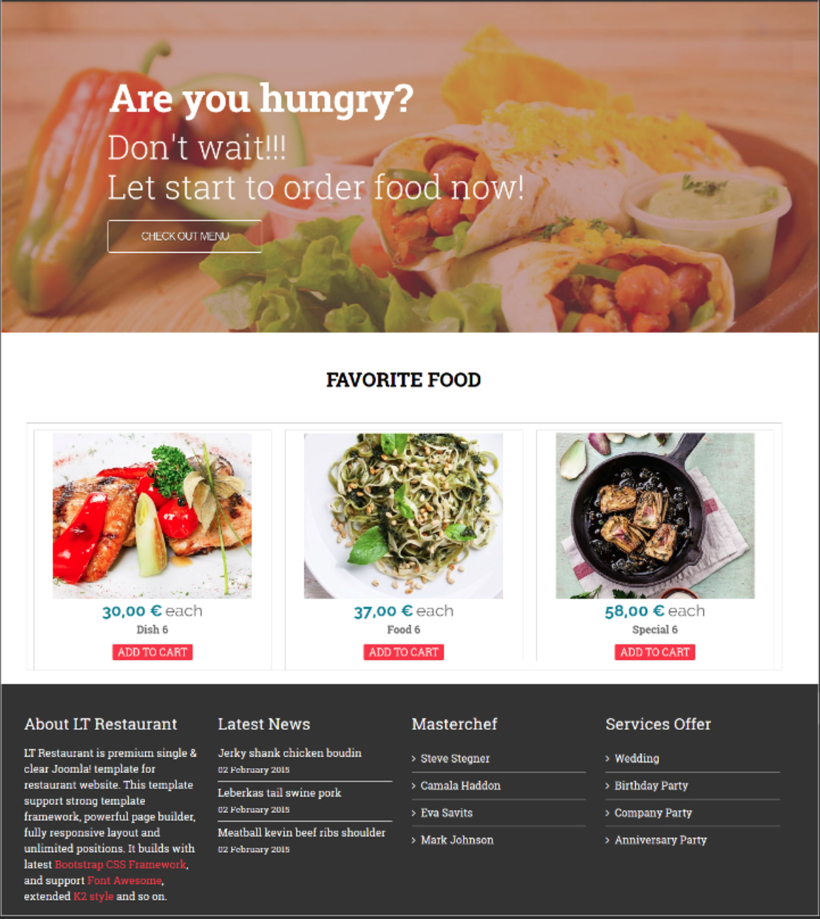
USER INTERFACES

Slide 19
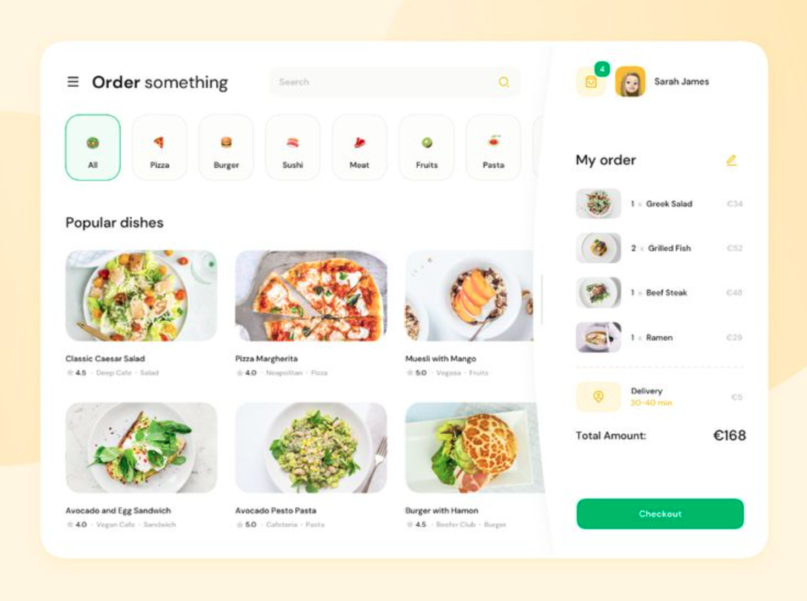
USER INTERFACES

Slide 20
TOOLS BEING USED
Frontend Development Tools:
HTML (Hyper Text Markup Language):
HTML will be used for structuring the content of the website. It will define the layout and the basic elements such as forms, buttons, and links needed for user interaction.
CSS (Cascading Style Sheets):
CSS will be used to style the user interface, ensuring the website is visually appealing, responsive, and user-friendly. It will handle the layout, colors, fonts, and overall presentation of the site.
JavaScript:
JavaScript will be used to add interactivity to the website. It will be responsible for client-side validations, form submissions, real-time updates, and dynamic interactions, such as showing available ambulances based on user input.
Bootstrap:
Bootstrap, a popular CSS framework, will be used to quickly design and develop a responsive and mobile-friendly interface. It provides pre-built components, such as navigation bars, buttons, and forms, which will speed up the development process.

Slide 21
TOOLS BEING USED
Backend Development Tools:
PHP (Hypertext Preprocessor):
PHP will be used for server-side scripting. It will handle user authentication, ambulance booking logic, database interactions, and payment integration. PHP is an ideal choice for building dynamic, data-driven web applications.
SQL (Structured Query Language):
SQL will be used for managing and querying the database. It will be used to store user data, ambulance availability, booking details, payment records, and service feedback.
MySQL (Database Management System):
MySQL will be used to store and manage the system’s data. It is a relational database system that integrates well with PHP, ensuring smooth data management and retrieval for the ambulance booking system.

Slide 22
TOOLS BEING USED
3. Development Environment:
Sublime Text
Sublime Text will be used as the primary code editor for writing HTML, CSS, JavaScript, PHP, and SQL scripts. It provides a powerful, feature-rich environment with extensions for debugging and code management.
XAMPP/WAMP (Local Server):
XAMPP or WAMP will be used for setting up a local server environment for PHP and MySQL. It will allow developers to run the application locally during development before deployment to the live server.

Slide 23


